Slide 1
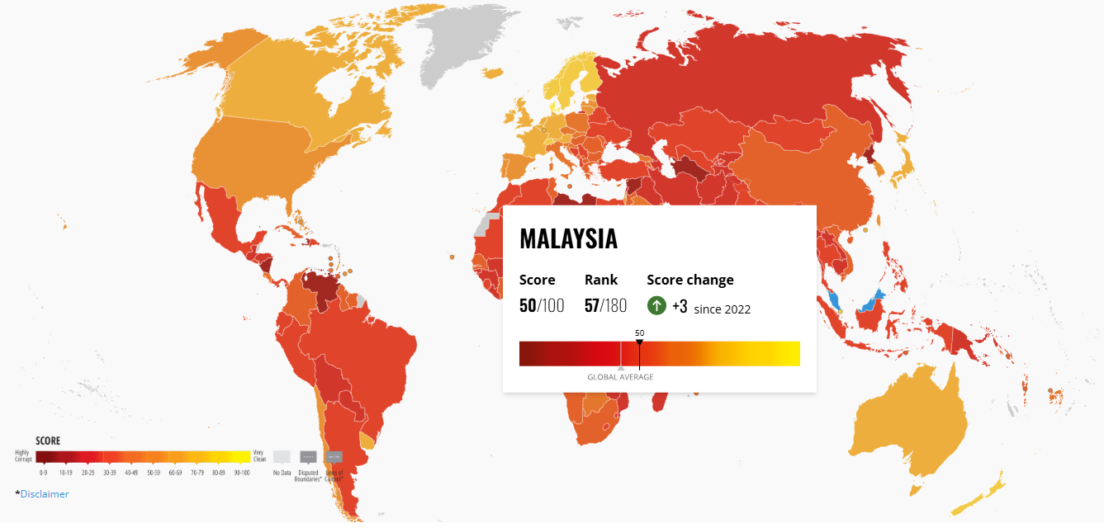
MPU-3302: INTEGRITY AND ANTI-CORRUPTION
RSD Group 5
Student Name:
Chia Ming Yi
Ong Yi Xin
Lim Jun Wei
Ng Ian Kai

Slide 2
Introduction to Integrity and Anti-Corruption

Slide 3
1. What is integrity and anti-corruption
Fundamental pillars
Maintain trust and accountability
Integrity
Honest and ethical principles
Anti-Corruption
Prevent, Detect and address.

Slide 4
Selection of Case Study

Slide 5
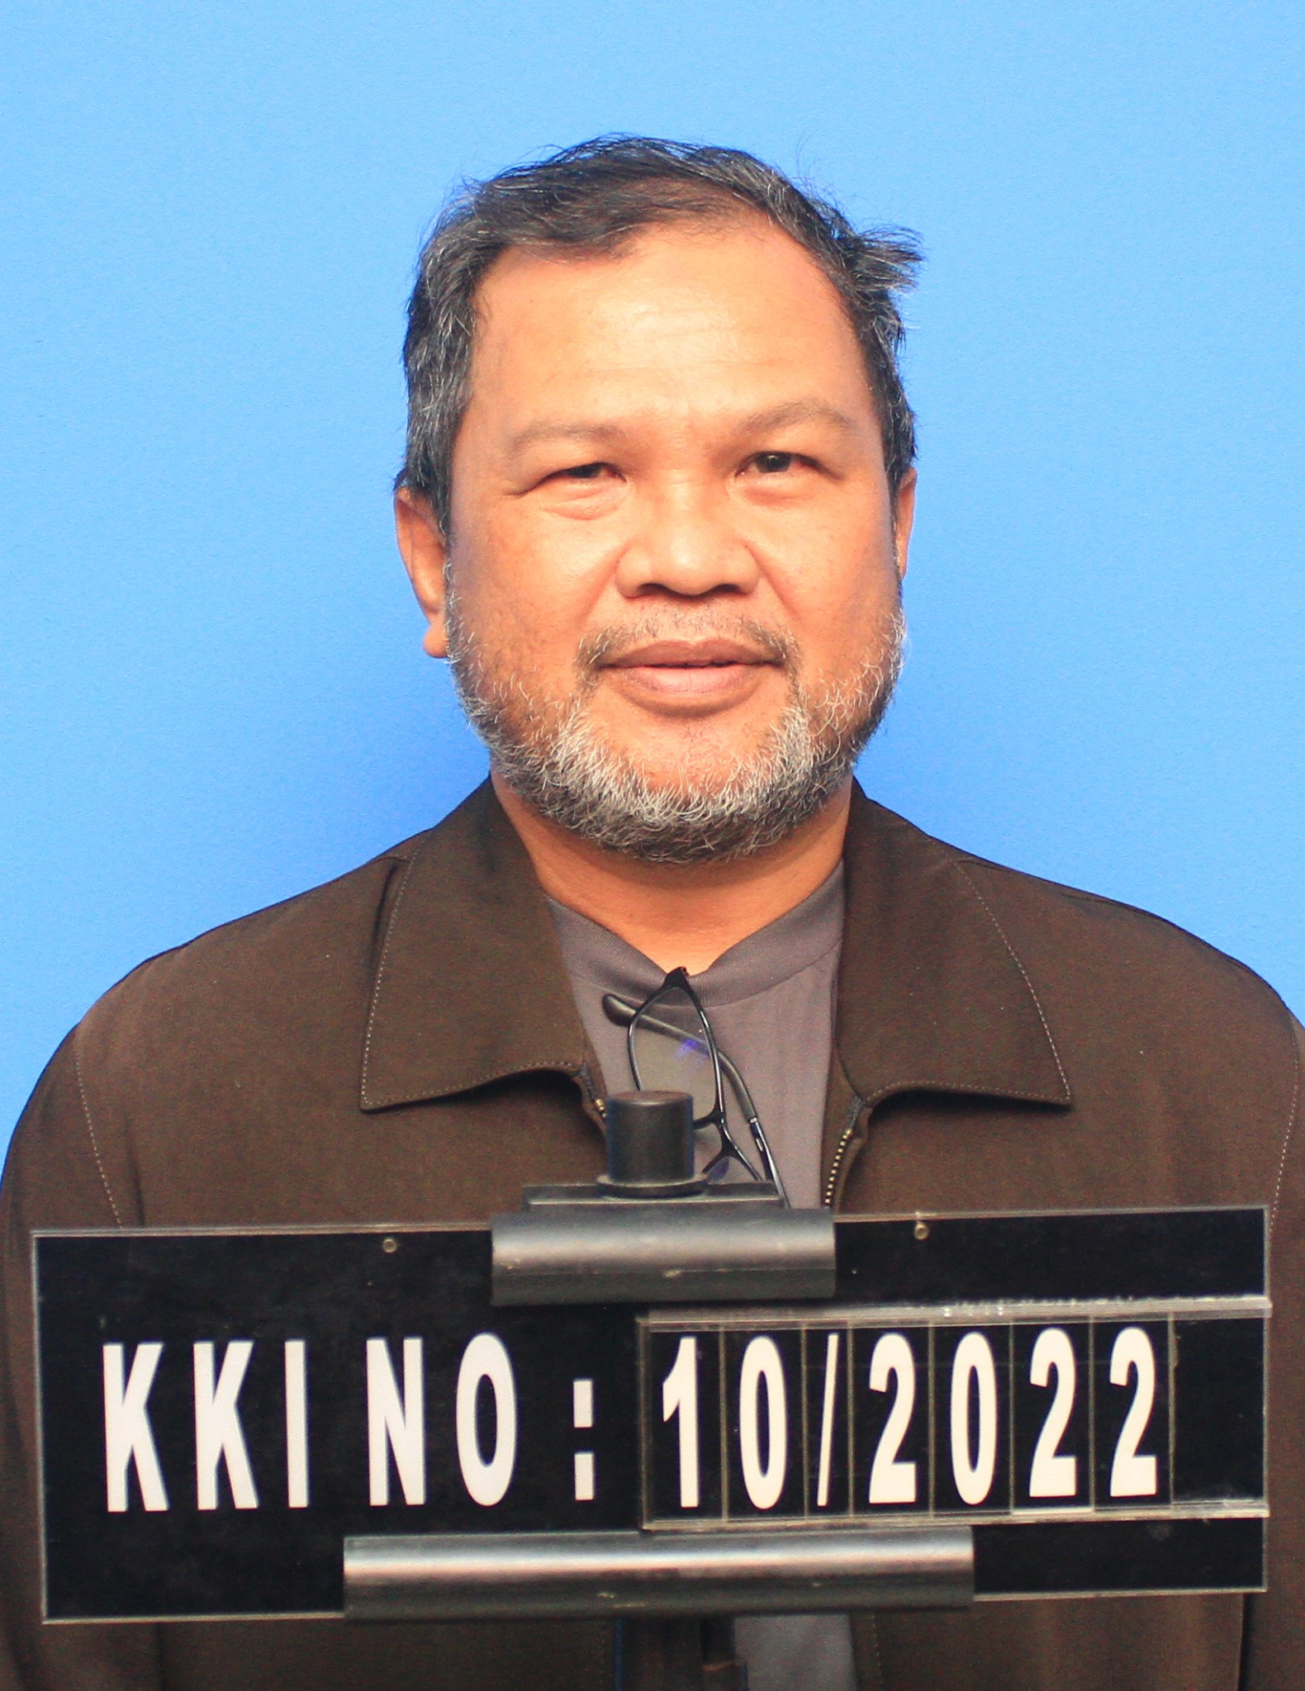
Selection of Case Study
Case Study of Corruption Case
Offender: Marsam Buhera, College Dean
Place: Eastern College, Kota Kinabalu
Case: Falsifying documentation & make claim in Eastern College Office Supervisor Program

Slide 6
Selection of Case Study
Violation of Human Welfare
Corruption can be done by anyone, in any form & anywhere
Know importance of human welfare
Greed of Human Nature
High expectation & dissatisfaction → illegal action
Warn people not to fall into corruption traps due to momentary greed

Slide 7
Selection of Case Study
Misuse of Power
Higher position & more power ≠ Allow to abuse power
Appeal for ethical and legal uses of power
Promote Self-Awareness
Stimulate people’s self-awareness towards corruption
Protect themselves against corruption seduction

Slide 8
Overview of the Chosen Case Study

Slide 9
1. Background Information
Case Study Background
Marsam Buhera, the dean of Eastern College
Committing fraud by submitting false claims to secure government funds
Many stakeholders are affected
Limit employee privileges based on roles and responsibilities
Well-respected institution known for its quality programs
An organization that should uphold the highest standards of honesty and integrity
This case shows a serious violation of trust
Huge impact on the college’s reputation and operational integrity

Slide 10
2. Main Events
1. Fraudulent Activities:
3. Legal Proceedings:
Scandal of falsifying documents
Inflated student numbers and provided false data, frauding RM 267,000.
Charged with financial misconduct.
Found guilty and ordered to pay a fine of RM 180,000 or longer time in prison.
2. Discovery and Investigation:
4. Penalties and Consequences
Auditors noticed discrepancies in the financial documents
Scandal of falsifying documents, to get extra government funds.

Slide 11
3. Key Stakeholders and Victims
STAKEHOLDER
Marsam Buhera: responsible for the fraudulent activities.
VICTIMS
Eastern College Office Management Supervisor Program
The Students and Faculty of the College
The Government and Regulatory Bodies

Slide 12
Ethical Dilemmas or Violations

Slide 13
1. Abuse of power and trust
Dean and administrator
Manage benefits of students
Use facilitator of position
Representative college and student

Slide 14
2. Fraud and deception
Fraud document
Company invoices
Trainee list
Trainee attendance forms
Receipt for trainee allowances

Slide 15
3. Impact on stakeholders
Students, college management and government
Trust become weaker
Resource wasted and abused
Who really needs cannot get the help

Slide 16
4. Systemic Issues and prevention
Review
Agency’s internal controls
Oversight mechanisms
Ethics
Bribe
Reimbursement and expenditure

Slide 17
Factors Contributing to the Ethical Issues

Slide 18
Factors Contributing to the Ethical Issues
Greed of Human
People always compare and want the best thing
Deduction for our case:
Dissatisfaction of current job salary
Economic Condition
Inability of low income families to maintain lives
Deduction for our case:
Facing Bankruptcy & unaffordable to maintain family lives

Slide 19
Factors Contributing to the Ethical Issues
Laxity of Law
Lax law → ignorance of law
Deduction of our case:
Belief of not being arrested by police or getting light punishment
Cultural or Social Norms
Blindly imitate human behaviours without concerning of ethicality and legality
Deduction of our case:
Copying others’ modus operandi for obtaining money

Slide 20
Impact of the ethical issues on the organization and individuals involved

Slide 21
1. Impact on the Organization
Lowered reputation
Trust broken
Potential students choosing more trustworthy institution
Financially strained
Harder to form partnerships
6. Limited growth
7. Reduced educational quality
8. Less competitive and less attractive
9. Operational challenges

Slide 22
2. Impact on the Individuals
Marsam Buhera
Legal penalties
Career ending
Name associated with corruption
Students
Questioning the value of their education
Questioning the integrity of their degrees
Demotivated and bad overall experiences
Marsam’s Colleagues
Demoralized
Negative work environment

Slide 23
Potential Strategies to Address Ethical Dilemmas

Slide 24
1. Implementing Regular Monitoring and Evaluation
Prevent corruption and unethical behavior.
Assign multiple supervisors per department.
Regularly review processes, transactions, and behaviors.
Assess potential risks and develop mitigation strategies.
Limit employee privileges based on roles and responsibilities

Slide 25
2. Establishing Sufficient Whistleblower Protection
Encourage reporting of unethical behavior.
Ensure a safe and secure environment for whistleblowers.
Provide regular training on business ethics and reporting procedures.
Government support: MACC to offer 24/7 assistance and clear contact information.

Slide 26
3. Tightening Rules and Regulations
Clearly define and enforce acceptable behavior.
Display clear rules and regulations in conspicuous places.
Mandate transparency in operations, particularly in financial matters.
Impose strict penalties for rule violations.

Slide 27
4. Expanding Education Syllabus
Instill ethical awareness from a young age.
Introduce ethics subjects in the education syllabus.
Relate lessons to real-world scenarios across various contexts.
Foster integrity and ethical behavior as part of students' mental models.

Slide 28
Conclusion

Slide 29
Conclusion
Ethical integrity is crucial for maintaining organizational credibility and social trust.
Ethical behavior is a necessity, not an ideal.
Systemic reforms and personal accountability are essential.
Upholding ethical standards is key to operational effectiveness and public confidence.

